Slide 1


Slide 2


SQL SQUAD
GAYATRI BHAVAR
RINKU KATOLE
DIVYA BARI
KESHAR GUPTA
SARIKA
TRAINER VIKAS KALAL

Slide 3
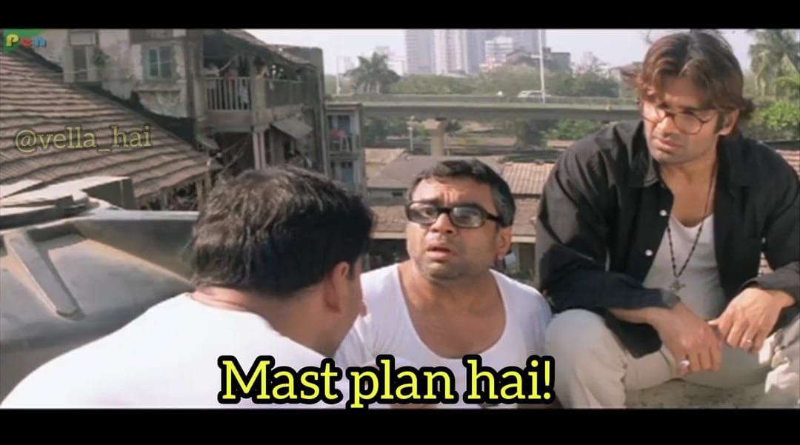
INTRO-: An Online Training Management System (0TMS) is a software platform designed to streamline, automate, and manage training programs—especially in corporate, educational, or professional development settings.
🎯 GOALS Centralized Learning Platform 24/7 Access to Learning Track Learner Progress Improve Training Efficiency ✅ Save Time 🕒 Flexible Timing

Slide 4
ER DIAGRAM
LOCATION
RESULTS
CATEGORY
COURSES
LOC_NAME
USER_ID
COURSE_ID
USERS
CATEGORY_ID CATEGORY_NAME
COURSE_ID
USER_ID
COURSE_NAME
DESCRIPTION
DURATION
FEES
TRAINER_ID
START_DATE
END_DATE
CATEGORY_ID
M
RESULT_ID
ASSESMENT_ID
USER_ID
MARKS_OBTAINED
USER_ID
NAME
EMAIL
PASSWORD
REG_DATE
ROLE
1
SCHEDULE
PAYMENT
SCHEDULE_ID
COURSE_ID
SESSION_DATE
START_TIME
END_TIME
TOPIC
PAYMENT_ID
USER_ID
COURSE_ID
AMOUNT
PAY_METHOD
P_DATE
ENROLLMENT
ASSESMENT
FEEDBACK
CERTIFICATE
ANNOUNCEMENT
ASSESMENT_ID
COURSE_ID
TITLE
TOTAL_MARKS
DATE
ENROLL_ID
USER_ID
COURSE_ID
ENROLL_DATE
STATUS
FEEDBACK_ID
USER_ID
COURSE_ID
ISSUE_DATE
DATE
CERTIFICATE_ID
USER_ID
COURSE_ID
ISSUE_DATE
COURSE_ID
ANNOUNCE_ID
DATE/TIME
TITLE
MESSAGE

Slide 5

TABLE CREATION
CREATE TABLE USER1
(
USER_ID NUMBER PRIMARY KEY AUTO INCREMENT,
USER_NAME VARCHAR(100),
EMAIL VARCHAR(50) UNIQUE,
PASSWORD VARCHAR(20) UNIQUE NOT NULL,
ROLE VARCHAR(30),
REG_DATE DATE
);
USER_ID USERNAME EMAIL PASSWORD ROLE REG_DATE
---------- ---------- ---------------------- ----------------- ------ ----------------
101 SHUBHAM SHUBHAM12@GMAIL.COM SHUBHAM@22 PYDEV 03-JUN-25
102 VEENA VEENA22@GMAIL.COM VEENA#22 DATAANALYST 05-JUN-25
103 JIVIKA JIVIKA10@GMAIL.COM JIVA%15 CLOUCOMPUTING 05-JUN-25
104 PARTH PARTH4@GMAIL.COM PARU*13 DATASCIENCE 25-MAY-25
105 ISHU ISHU6@GMAIL.COM ISHU$13 JAVADEVELOPER 23-MAY-25

Slide 6
CREATE TABLE CATEGORY
(
CATEGORY_ID VARCHAR(20) PRIMARY KEY,
CATEGORY_NAME VARCHAR(20) NOT NULL
);
CATEGORY_ID CATEGORY_NAME
-------------------- --------------------
C001 SOFTWARE DEVLOPMENT
C002 DATA SCIENCE
C003 FRONTEND DEVLOPMENT
C004 FULL_STACK_DEV
C005 NETWORK SECURITY

Slide 7
CREATE TABLE COURSE
(
COURSE_ID NUMBER(10) NOT NULL PRIMARY KEY,
COURSE_NAME VARCHAR2(100) NOT NULL,
DURATION VARCHAR2(50),
DESCRIPTION VARCHAR2(50),
FEES NUMBER(10),
START_DATE DATE,
END_DATE DATE,
CATEGORY_ID NUMBER(10),
TRAINER_ID VARCHAR2(50),
USER_ID NUMBER NOT NULL,
CONSTRAINT UID_FK FOREIGN KEY (USER_ID) REFERENCES USER1(USER_ID)
);

Slide 8
CID | USER_ID | CATEGORY_ID | CO_NAME | DURATION | DESCRIPTION | FEES | START_DATE | END_DATE
201 | 101 | C001 | PYTHON PROGRAMMING | 3 MONTHS | BEGINNER TO | 30000 | 15-Jul-25 | 15-Oct-25
202 | 102 | C002 | DATA SCIENCE | 4 MONTHS | DATA ANALYSIS | 25000 | 01-Aug-25 | 25-Dec-25
203 | 103 | C003 | WEB DEVELOPMENT | 3 MONTHS | HTML CSS JS | 18000 | 20-Jul-25 | 20-Oct-25
204 | 104 | C004 | JAVA FULL STACK | 5 MONTHS | JAVA SPRING MYSQL | 30000 | 01-Sep-25 | 01-Feb-25
205 | 105 | C005 | CYBER SECURITY | 4 MONTHS | NETWORKING | 28000 | 15-Aug-25 | 15-Dec-25

Slide 9
CREATE TABLE ANNOUNCEMENT
(
ANNO_ID NUMBER NOT NULL PRIMARY KEY,
TITLE VARCHAR(100) NOT NULL,
MESSAGE VARCHAR(100),
DATE_TIME VARCHAR(50),
COURSE_ID NUMBER(10) NOT NULL ,
CONSTRAINT CID_FK FOREIGN KEY(COURSE_ID) REFERENCES COURSE(COURSE_ID)
);
ANNO_ID | TITLE | MESSAGE | DATE_TIME | COURSE_ID
701 | WEB_TECH | STARTED | 23-Jun-25 | 201
702 | SPOKEN_ENGLISH | STARTED | 20-Oct-25 | 202
703 | CYBER_SECURITY | ENDED | 10-Nov-25 | 203
704 | APTITUDE | TODAY | 15-Jun-25 | 204
705 | PYTHON_DEMO | STARTED | 30-Jun-25 | 205

Slide 10
CREATE TABLE SCHEDULE
(
SCHED_ID NUMBER PRIMARY KEY ,
TOPIC VARCHAR(50) NOT NULL,
START_TIME VARCHAR(20),
END_TIME VARCHAR(20),
SESSION_DATE DATE,
USER_ID NUMBER NOT NULL,
CONSTRAINT COURSE_ID_FK FOREIGN KEY(USER_ID) REFERENCES USER1(USER_ID)
);
TOPIC | START_TIME | END_TIME | SESSION | USER_ID
SQL DQL | 12:00 | 02:00 | 01-APR-25 | 101
SQL | 08:00 | 10:00 | 02-MAY-25 | 102
HTML | 01:00 | 03:00 | 09-MAY-25 | 103
JAVA | 10:00 | 12:00 | 23-APR-25 | 104
JAVA | 12:00 | 02:00 | 23-AUG-25 | 105

Slide 11
CREATE TABLE CERTIFICATE
(
CERT_ID NUMBER PRIMARY KEY,
CERT_URL VARCHAR2(100) UNIQUE,
COURSE_ID NUMBER(10) NOT NULL,
USER_ID NUMBER NOT NULL,
ISSUE_DATE DATE,
CONSTRAINT CUID_FK FOREIGN KEY(COURSE_ID) REFERENCES COURSE(COURSE_ID),
CONSTRAINT USID_FK FOREIGN KEY(USER_ID) REFERENCES
USER1(USER_ID)
);
CERT_ID | CERT_URL | COURSE_ID | USER_ID | ISSUE_DATE
111 | https://example.com/certs/1 | 201 | 101 | 23-Jan-25
112 | https://example.com/certs/2 | 202 | 102 | 20-May-25
113 | https://example.com/certs/3 | 203 | 103 | 01-Jan-25
114 | https://example.com/certs/4 | 204 | 104 | 23-Feb-25

Slide 12
CREATE TABLE ASSESMENT
(
ASSIS ID NUMBER(20) PRIMARY KEY,
TLILE VARCHAR(30),
TOTAL MARKS NUMBER(5,2),
CID NUMBER(10),
DUE_DATE DATE,
CONSTRAINT COID FK FOREIGN KEY (CTD) REFFRENCES COURES4(CID)
);
ASSIS_ID TITLE TOTAL_MARKS CID DUEDATE
--------- ------------------------------ ----------- ---------- ---------
121 SQL 70.6 201 10-MAY-25
122 JAVA 89.45 202 20-APR-25
123 WEB DEV 85 203 01-JUN-25
124 JAVA FULL STACK 75 204 03-JUL-25
125 CYBER SECURUTY 95.9 205 15-JAN-25

Slide 13
CREATE TABLE PAYMENT
(
PAY ID VARCHAR(50) PRIMARY KEY,
USER ID NUMBER,
CID NUMBER(10),
AMOUNT NUMBER(30),
P METHOD VARCHAR(25),
P_DATE DATE,
CONSTRAINT COUR_ID_FK FOREIGN KEY(CID) REFERENCES COURES4(CID)
);
PAY_ID | USER_ID | CID | AMMOUNT | P_METHOD | P_DATE
505 | 101 | 201 | 25000 | ONLINE | 20-Jul-25
506 | 102 | 202 | 50000 | OFFLINE | 05-Aug-25
507 | 103 | 203 | 18000 | ONLINE | 05-Sep-25
508 | 104 | 204 | 3000 | OFFLINE | 16-Aug-25
509 | 105 | 205 | 28000 | ONLINE | 19-Aug-25

Slide 14
CREATE TABLE RESULT
(
RESULT ID NUMBER(20) PRIMARY KEY,
ASSIS ID NUMBER (20),
USER ID NUMRER,
SCORE VARCHAR(30),
CONSTRAINT USEID FK FOREIGN KEY(USER ID) REFERENCESUSERY(USFR_ID)
);
RESULT_ID | ASSIS_ID | USER _ID | SCORE
401 | 121 | 101 | 2
402 | 122 | 102 | 1
403 | 123 | 103 | 3
404 | 124 | 104 | 1
405 | 125 | 105 | 1

Slide 15
CREATE TABLE LOCATION
(
LOC_NAME VARCHAR(20),USER_ID NUMBER(10),
CID NUMBER(10),
CONSTRAINT USID_FK FOREIGN KEY(USER_ID) REFERENCES USER1(USER_ID)
):C
LOC_NAME USER_ID COURSE_ID
PUNE 101 201
NAGPUR 102 202
MUMBAI 103 203
NASHIK 104 204
KOLHAPUR 105 205

Slide 16
LEARN ANYTIME ,
ANYWHERE
SAME TRAINING FOR EVERYONE
ADVANTAGES
SAVE MONEY
WORK FOR MANY PEOPLE AT ONES
EASY TO USE

Slide 17


Slide 18
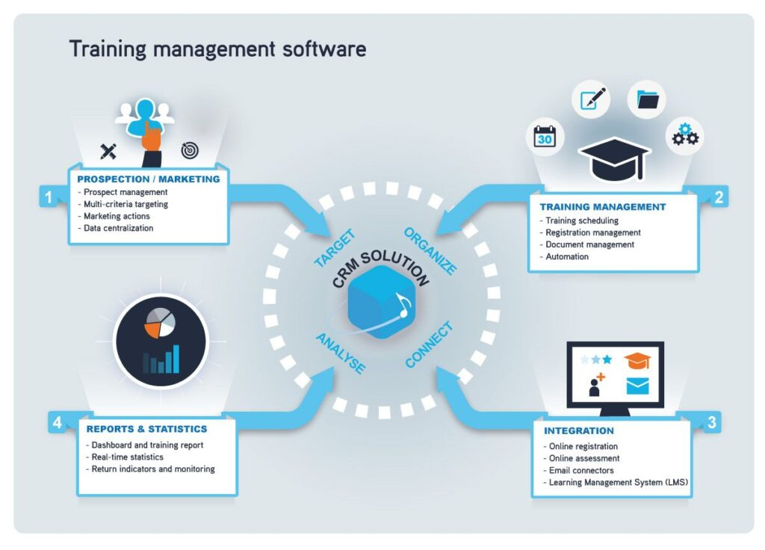

Slide 19


Slide 20


Slide 21


